Slide 1
Module : OP&E Tools
Space Management Capability
Notes:
Good Morning/ Afternoon
Today my main objective is to keep you” awake and interested” in understanding the overall technical foundation.
Feel free to ask any questions you may have; we will answer immediately or at the end of the chapter.
A little logistic reminder > please switch off your portables. Thanks

Slide 2
Sign-off Control Section
Name | First Name | Function | Document Version | Date | Signature
Le Maout | Robert | TME University lead | Final
Witt | Matthew | Laptop Deployment lead | Final

Slide 3
Objectives of this module
After this module, you will be able to
  Understand how the TME applications support the BP processes for Space Management
  Create Space Propositions
  Review Space data in Siebel Analytics
Notes:
Review key objectives as documented on the slide with your participants.

Slide 4
Table of Contents
Introduction to Better Practices for Space Management
  Definition
  Process Overview
  Capability Interdependencies
Tool support for Space Management processes
  JTI versus Siebel Terms
  Tool support
  Tool step overview by BP process
  Tool steps in detail
Demo & Exercises
  Tool demo
  Exercises
Notes:
As presented this morning by Roberto, Martin, Andrew, the new markets dynamics and challenges will require a new approach & strategy on how we will tackle the trade marketing activities.
And as a result, we have defined some Better Practices to support the new ways of working on the Trade Marketing
But, What does this mean from Better Practices & New ways of working?
We have discovered the new 10 capabilities that will support this process and Right Now, let’s review together how the “IT tools” will support them.

Slide 5
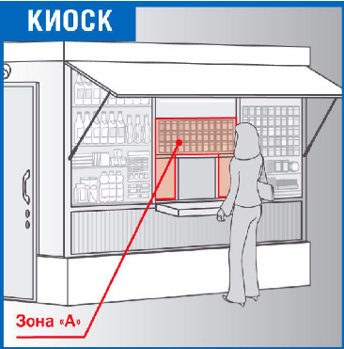
Introduction
Space Management - Definition
Space Management:
  Space Management is the process of developing Space Management guidelines and planograms to maximize the financial and commercial value of the assortment. A planogram details the optimal SKU placement and space allocation within the Tobacco category space, as well as the optimal placement of the Tobacco category in the Outlet (e.g. store).

Slide 6
Introduction
Space Management – Process Overview
Process Overview
Process Description
Review budget, optimal generic assortment & comp. insight
Review the available budget, the generic assortment per channel/segment/cluster for the whole tobacco category and the JTI assortment. Review the competitors positioning within the channel / segment / cluster.
F1
F1
Develop generic macro space propositions
Yearly
Define the location of the tobacco category within a typical outlet layout, the space required for the tobacco category within a typical outlet of the channel / segment / cluster, the positioning of the tobacco sub-categories within the shelf.
F2
F2
Develop generic micro space propositions
Define the positioning of the product segments and the required shelf space for each product segment. Define the positioning and shelf space for each SKU for JTI brands only. (Per channel / segment / cluster )
F3
F3
Dev. guidelines for optimal impl. of the generic space proposition
Develop guidelines to ensure an optimal implementation at the outlet of the JTI part of the generic planogram. Develop an implementation and monitoring plan and guidelines for a selling story. (Only for JTI products)
F4
F4
Customize space proposition/ planogram by account / outlet
Ad Hoc
Develop an optimized space proposition for strategic account (format)/ outlet where justified. Develop an implementation and monitoring plan and a selling story. (Only for strategic accounts / outlets)
F5
F5
Ensure execution at POP / POC
Communicate the planogram agreement and implementation plan and execute at POP / POC.
F6
F6
Measure / evaluate space proposition effectiveness
Quarterly
Measure the space proposition compliance against space proposition agreement and implementation plan. Measure space proposition effectiveness. Issue evaluation report.
F7
F7

Slide 7




Introduction
Space Management – Interdependencies
Space Management concerns 3 TME roles for planning and execution:
  The Category Developer
  The Trade Marketer
  The Operational Planner
Brand Mgmt
Channel/Segment Mgmt
Key Account Mgmt
→ Strategies, Objectives and Guidelines
Category Developer
Operational Planner
Trade Marketer
Responsible for
Reviewing historical data in Siebel Analytics
Planning and setting up new Space Propositions in Siebel Sales CG
Measuring Space Proposition effectiveness
Responsible for
Preparing the work plan for the Trade Marketers using Siebel Sales CG
Analyzing the TM effectiveness in Siebel Analytics
Responsible for
Ensuring compliance of the Space Proposition at the POC/POP
Executing Retail audit activities
Providing input in Siebel Sales CG during Outlet visits
Notes:
Verify the caller’s contact and address information by opening the Account Address multi-value group (MVG). If the appropriate address does not exist, you can create a new one by clicking the New button on the MVG and entering the information.

Slide 8

Introduction
Space Management – Interdependencies
Trade
Marketers
Brand
Channel & Segment
Account Mgmt
Review budget,
optimal generic
assortments & competitor insight
Visit Reporting
Guidelines
Objectives
Strategies
Channel/Segment
Program Guidelines
Agreements
Retail audits
Siebel Analytics
1
Measure & Evaluate Space proposition effectiveness
7
Category Developer
2
Develop Generic
Macro Space Proposition
Siebel Analytics
Plan visits & activities
Siebel
Sales
Ensure execution
at POP / POC
6
3
Develop Generic
Micro Space Proposition
Space
Management
Planogram agreement
& implementation plan
5
4
Operational
Planner
Develop Guidelines for optimal implementation
Customize
Space Proposition (for
Strategic Outlets only)
Siebel
Sales
Spaceman

Slide 9
Table of Contents
Introduction to Better Practices for Space Management
  Definition
  Process Overview
  Capability Interdependencies
Tool support for Space Management processes
  JTI versus Siebel Terms
  Tool support
  Tool step overview by BP process
  Tool steps in detail
Demo & Exercises
  Tool demo
  Exercises
Notes:
As presented this morning by Roberto, Martin, Andrew, the new markets dynamics and challenges will require a new approach & strategy on how we will tackle the trade marketing activities.
And as a result, we have defined some Better Practices to support the new ways of working on the Trade Marketing
But, What does this mean from Better Practices & New ways of working?
We have discovered the new 10 capabilities that will support this process and Right Now, let’s review together how the “IT tools” will support them.

Slide 10
Tool support for Space Management
JTI versus Siebel Terms
JTI term
Siebel term:
Product Product
Product segmentation Product Catalog & Categories
Period Season
Segments, Clusters Planning Groups
Outlets Accounts
Accounts Accounts
Assortment Proposition Assortment Plan
Space Proposition Assortment Plan
Retail audit Retail Audit (Actual Assortment)
Location Merchandising Location

Slide 11
Tool support for Space Management
JTI versus Siebel Terms
Location (Merchandising Location)
Locations are the various places in an outlet where the tobacco products are sold: back wall, counter, express check-out, vending machine...
Outlets might have:
  Primary locations: usually the largest place where products are available
  Secondary locations
Merchandising Location is the Siebel term for location

Slide 12
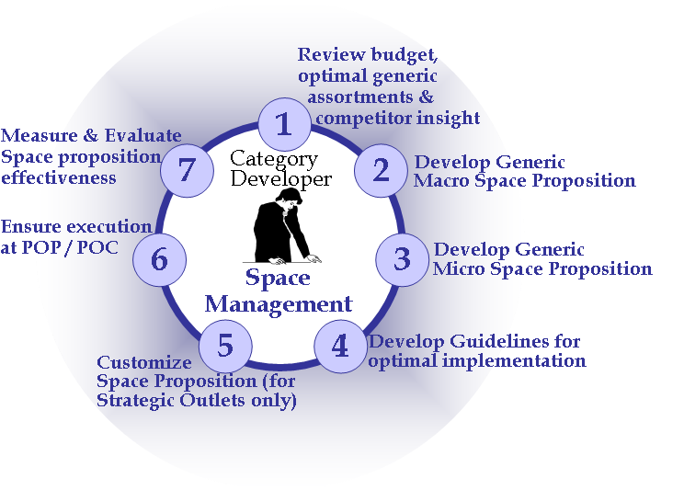

F.1. Review generic assortments and comp. insight
Tool support
The Category Developer can review and analyze
historical data from the Dashboards in Analytics
Input:
From who What
Tool
support
ASP
Competitor Reports
Guidelines
Process
action
Siebel
Sales
Category
Developer analyzes macro and micro trends & objectives
via File Upload
Brand Marketing
Channel / Segment /
Account Mgmt
Space Proposition Compliance Data
Sales : “Literature” screen
Analytics: Space Dashboards
via Siebel Sales CG
Space Dashboards
Trade Marketers

Slide 13
F.1. Review generic assortments and comp. insight
Siebel Analytics Dashboards
Siebel Analytics supports BP Space Management
by 3 global dashboards
The first Better Practice process F.1 concerns the same type of analysis as the “E.1 Review and analyze” process of Assortment Management. Therefore the “Review Input” dashboard for Assortment Management can be used for insight analysis for Space Management. This dashboard is described in the Assortment Management Tool Training Module
Space Management
Assortment Dashboard
Review Input
Spacing Proposition
Evaluate Spacing
Performance by Product
Consumer Profile
Assortment Performance
Key performance Indicators
Competitive Performance
Category Performance
Spacing Proposition Effectiveness

Slide 14
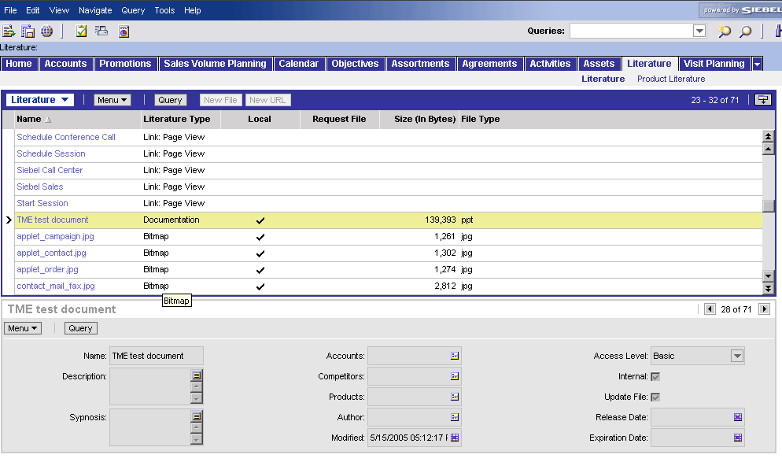
F.1. Review generic assortments and comp. insight
Siebel Sales support: The “Literature” screen (1/2)
View:
Tool actions:
  Literature screen shows all information which can be downloaded for different purposes: the ASP, Merchandizing catalog, competitor reports, Sales presentations, contracts, etc.
  Access to the files depends on your user rights
  Searching for a specific file can be done through scrolling up and down or either using the Query Function

Slide 15
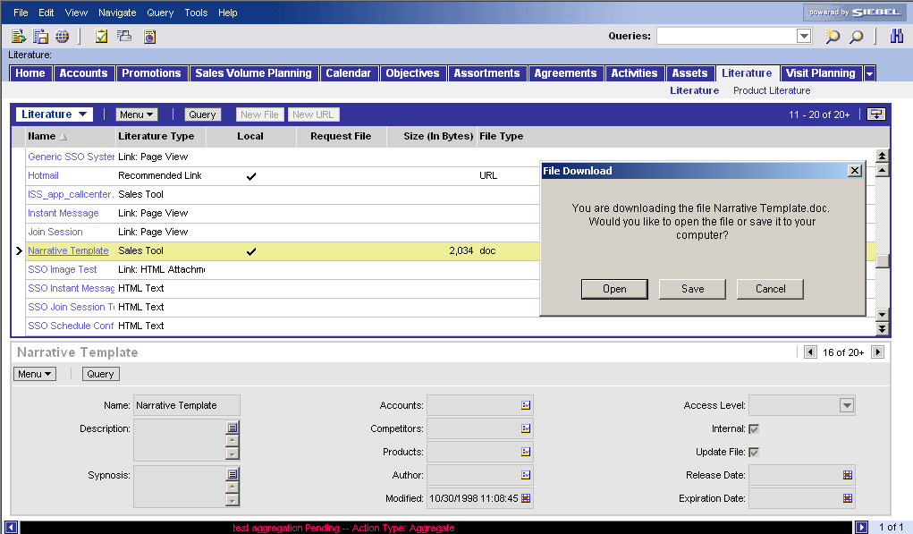
F.1. Review generic assortments and comp. insight
Siebel Sales support: The “Literature” screen (2/2)
How to access file in Literature screen
Access the “Literature” screen (click on Tab “Literature”)
Search document
  by scrolling down (drag scroll bar with mouse)
  by using the query function (click on query and fill in fields to narrow the selection of the list of files in the Literature view)
Open the file
  Click on file
  Choose “Open” or “Save” (to have local copy on hard drive)
1
2a
3a
3b
2b
You can not modify files in the Library, only local copies of the file on your hard drive

Slide 16
F.2. / F.3. Develop Generic Space Proposition
Tool support
After the Category Developer has defined the
generic assortment proposition, he will define a
generic space proposition for different channels,
segments, clusters. First for the Tobacco Category (F.2)
then a more detailed for the sub-categories and product segments (F.3)
Generic Assortment Plan
Tobacco
Category Performance
@
Channel/Segment/Cluster
Space Requirements
&
Consumer behavior studies
Size of Space
&
Ideal Location
Generic Space Proposition
Facing Importance
Planned # Facings
Target Relative Position

Slide 17

F.2. / F.3. Develop Generic Space Proposition
Tool steps
The Category Developer reviews all the insight
available to extend the generic assortment
proposition with the appropriate space proposition
Building the Space Proposition means completing more
detailed information in the existing Assortment Proposition
Perform analyses in the Spacing Proposition dashboard
Analytics
F.2 Macro
F.3 Micro
Review the generic assortment proposition (mix & facing importance)
Define target facings and relative position for the tobacco category
Calculate facings for sub-categories and product segments
Define relative position and facings at SKU level
Review assortment and space proposition for all products
Sales
Spaceman

Slide 18
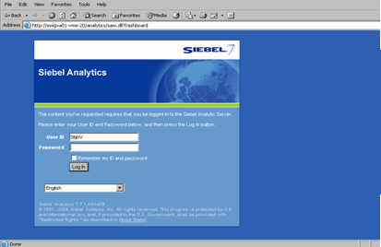
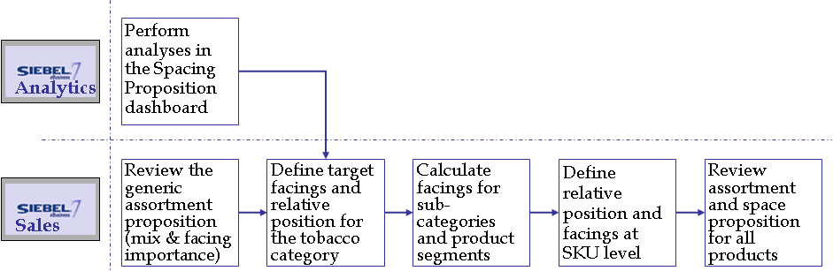
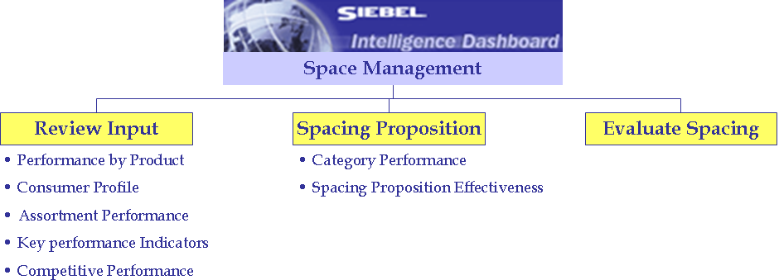
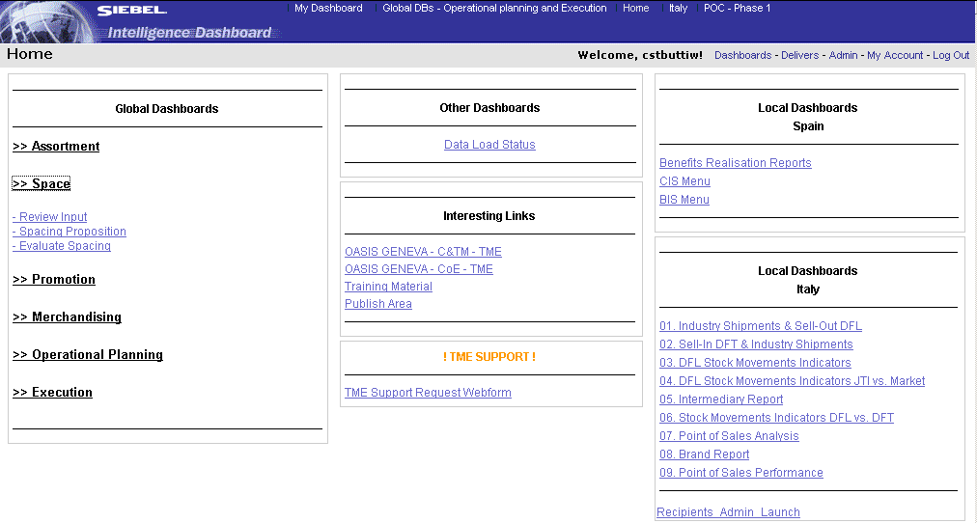
F.2. / F.3. Develop Generic Space Proposition
Access Space Management dashboards
1
3
2
4
How to open the Spacing Proposition dashboards
In an Internet Browser, enter the URL of the Siebel Analytics application
In the Login Page, enter
  User ID
  Password
  Language
The Home Page opens
Navigate to the dashboard
  Click on the “Space” link
  Click on the “Spacing Proposition” link

Slide 19
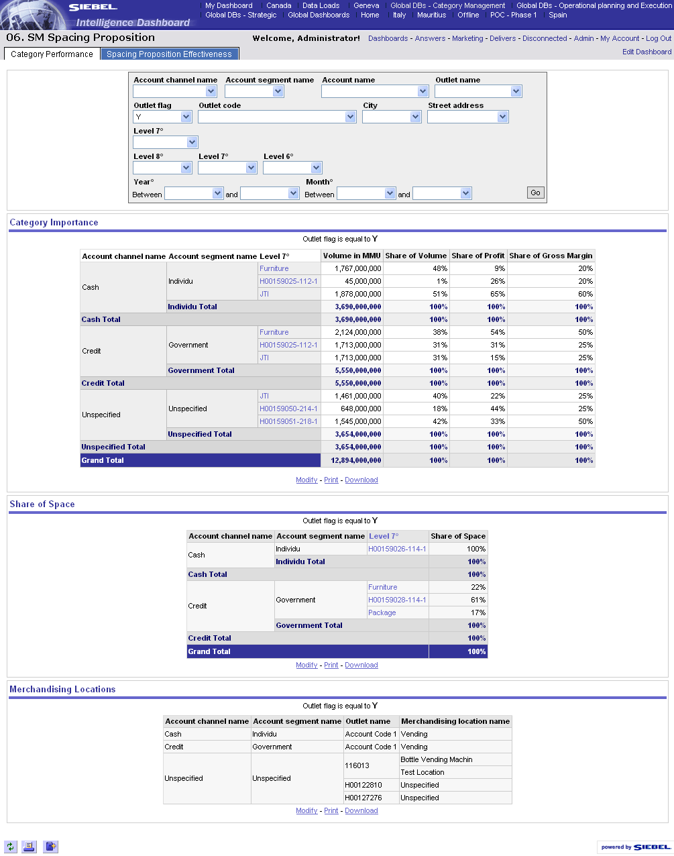
F.2. / F.3. Develop Generic Space Proposition
Dashboard – Category Performance
1
2
3
4
5
How to analyze the category performance?
Select values for the query
Define the period
Click GO
Review the reports
  Category Importance
  Share of Space
  Merchandising Location
Drill down for further investigation
on a lower level
(possible where light blue values)

Slide 20
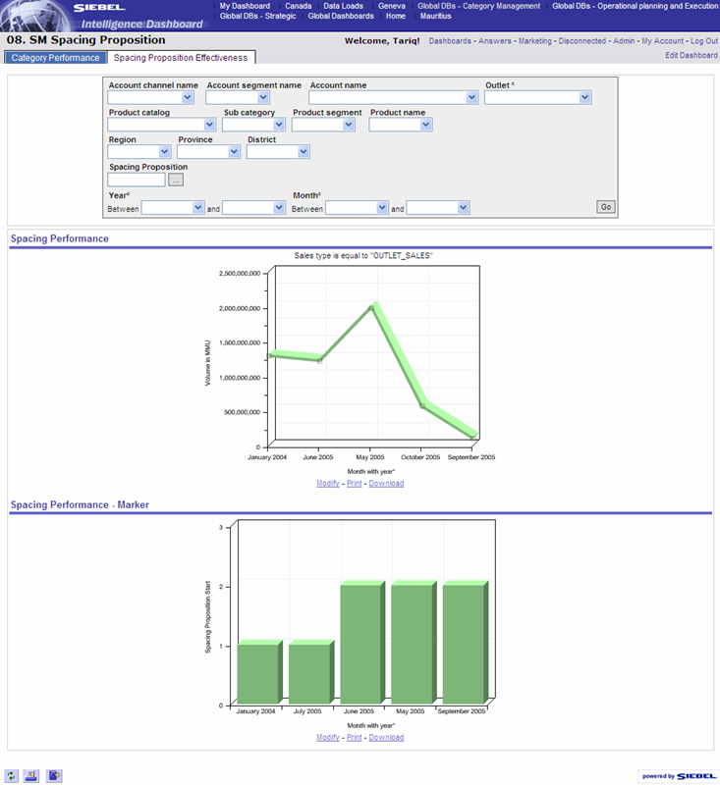
F.2. / F.3. Develop Generic Space Proposition
Dashboard – Spacing Proposition Effectiveness
1
2
3
4
5
6
How to analyze the historic effectiveness of a Spacing Proposition?
Click on the tab “Spacing Proposition Effectiveness” to open the according dashboard page
Select values for the query
Select the Assortment/Space Proposition
Define the period
Click GO
Review the reports
  Spacing Performance
  Spacing Performance - Market

Slide 21
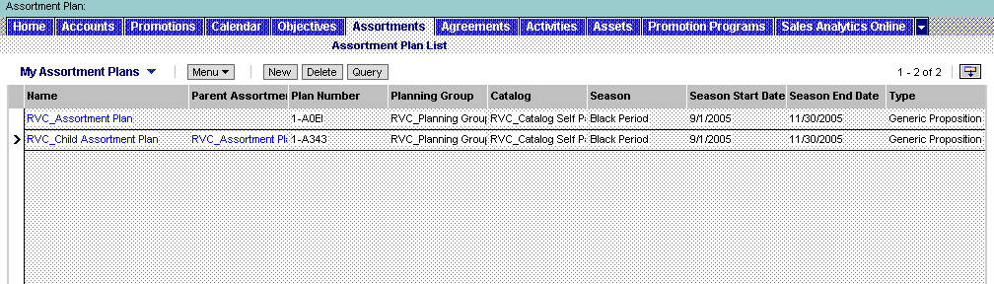
F.2. / F.3. Develop Generic Space Proposition
Review the generic assortment proposition
The Assortment proposition (plan) is created
according BP processes and tool steps described
in the Assortment Management module.
The product mix has been defined for each account (or merchandising location) of the planning group and so is the facing importance
The Category Developer will now add the details of the Spacing proposition according BP processes of Space Management.
First step: review the details of the generic assortment proposition
1
2
4
3
Open an existing Assortment Proposition?
Navigate to the “Assortments” screen
Query for the specific Assortment plan
Review the main details
Drill down to open the underlying views
  Categories
  Products
  Attachments

Slide 22
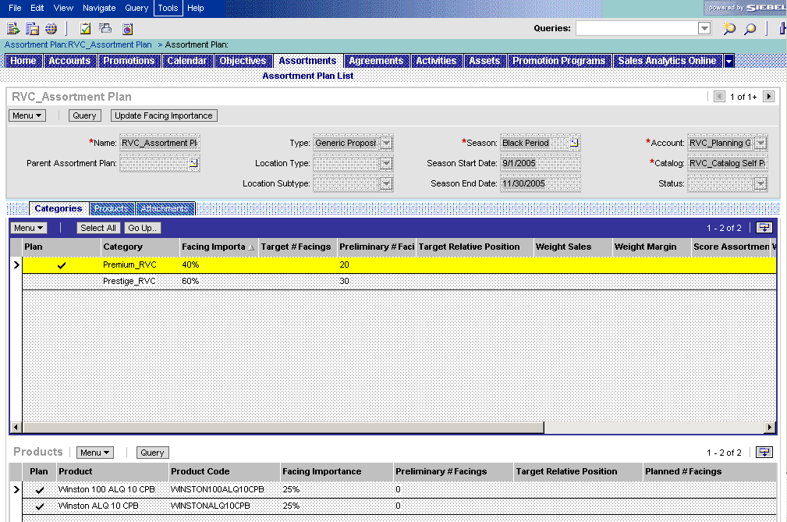
F.2. / F.3. Develop Generic Space Proposition
Review the generic assortment proposition
Review the assortment mix in the categories
view and the facing importance for each level
5
1
3
2
4
Review the assortment mix
Drill down on the assortment plan in the list view and navigate to the “Categories” view
In the upper list applet, review the Category, Sub-Category and Product Segments by drilling down
Review for each level whether it is included in the assortment mix (box = checked)
Review the facing importance for each level
To review the relative facing importance for each level, press the “Update Facing Importance” button

Slide 23
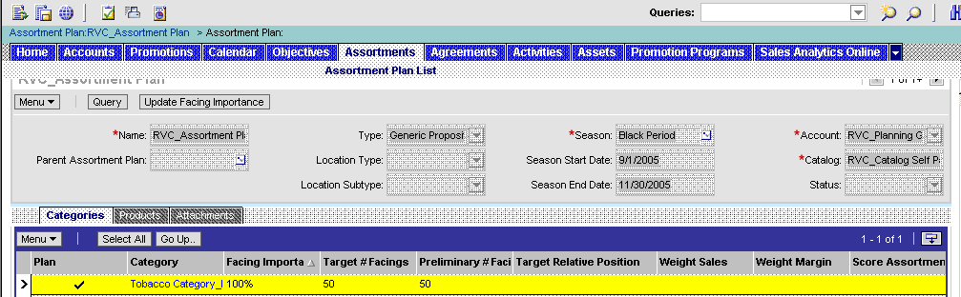
F.2. / F.3. Develop Generic Space Proposition
Define target facings and target relative positions
Define target facings and target relative position
for the Tobacco Category
Define target facings and target relative position for the Tobacco Category
Taking into account the type of accounts included in the planning group of this assortment proposition and the proposition analysis results, define for the tobacco category for this particular assortment the high level space propositon, i.e. the target number of facings and the target relative position
Go up to the 1st level Category (e.g. Tobacco Category)
Fill in the target # of facings for the total category (included all products of sub-categories)
Fill in the Target Relative Position for the entire assortment
1
2
3

Slide 24
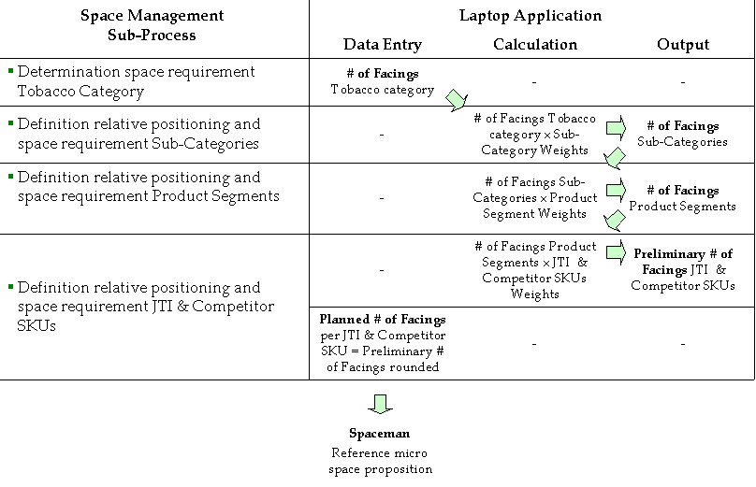
F.2. / F.3. Develop Generic Space Proposition
Define target facings and target relative positions
Start developing the micro space proposition
  Calculate/modify target # facings for sub-
  categories and product segments (how many?)
  Define for each product level the target relative positioning (where?)
The “Update Facing Importance” button facilitates top-down calculation
The “Update Facing Importance” button calculates 2 things:
The relative facing importance: the % facing importance on each level will be recalculated versus the total facing importance of the levels above
Under the condition that the facing importance is defined for each level and the target number of facings for the top level category (the Tobacco Category) had been defined, pressing the button will trigger the automic calculation of the target number of facings for all the levels below, down to SKU level

Slide 25
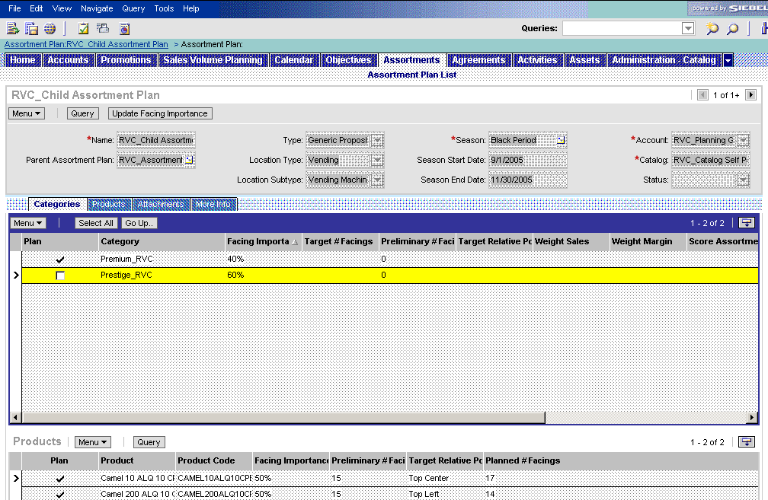
F.2. / F.3. Develop Generic Space Proposition
Define target facings and target relative positions
Tool steps: press the button, review and modify
target # facings or facing importance if required
1
Define for lower product levels the target # of facings and the target relative position
Press the Update Facing Importance button
Review the resulting target # facings for each product level (category)
Define the the target relative position for each product level (category)
Review all levels by
  Drilling down
  Going up
-> In case you want to modify
  Change the target # facings for the entire tobacco category (entire assortment plan)
  OR
  Change the facings importance of the levels you want to modify
  Press the Update Facing Importance button and repeat the process
4b
2
4a
3

Slide 26
F.2. / F.3. Develop Generic Space Proposition
Define target facings and target relative positions
Detail the final spacing proposition for all at SKU
level: Planned # Facings and Target relative
position
Define for all products selected for the assortment the spacing proposition
Drill down to the lowest level in the Categories list applet
Review the Target relative position for the product segment
Review the pre-calculated “Preliminary # facings for the products (this is not called target # facings because you can still modify at this level)
Define the planned # facings (should not vary much from the number in the preliminary # facings)
Define the target relative position for each SKU
Go up and repeat the same process for all product segments within the assortment mix
6
The following fields are copied to and consultable at outlet or merchandising location level (distribution lists & retail audit or retail audit location)
  Product
  Product Code
  Facing Importance
  Planned # Facings
  Target relative position
1
2
3
5
4

Slide 27
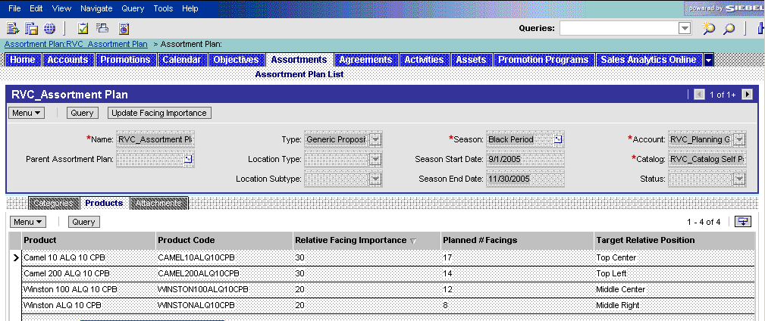
F.2. / F.3. Develop Generic Space Proposition
Review the products’ spacing propositions
Review the generic assortment and space
proposition for all the products within the mix
Review the final spacing proposition
Navigate to the “Products” view
Review all the relative facing importance, planned number of facings and the target relative position
In case you want to modify, go back to categories view and follow previously described steps
3
1
1
2
This view is read-only. You cannot modify any fields. It is a view for overview purposes

Slide 28
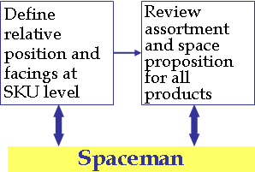
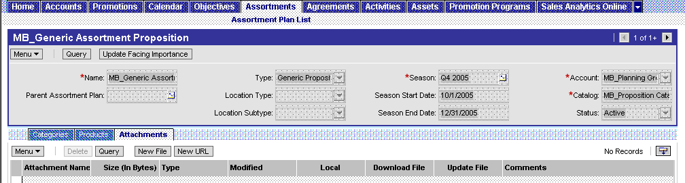
F.2. / F.3. Develop Generic Space Proposition
Interaction with Spaceman
The Spaceman application supports the definition and setup
of the micro space proposition, i.e. the target number and
relative position for all the products in the assortment mix
  Input for optimized planogram in Spaceman: The planned # of facings, together with the defined relative position of the sub-categories and product segments.
  Within Spaceman: reproduction of JTI products' relative positioning in Spaceman
  Output (input for Siebel Sales) :
    Spaceman planogram and related assumptions in Attachments view.
    Optimized target relative positions at product level (to be added manually)
Attach planogram and other useful info
Navigate to the Attachments view
Attach the Document (Guidelines, Spaceman planogram, etc.)
1
2

Slide 29
F.4. Develop Guidelines for optimal implementation
Tool support
The Category Developer will prepare documents to
optimize the implementation of the Assortment &
Space proposition (for JTI products only)
These documents include
  Guidelines to ensure an optimal implementation of the generic micro space proposition at the outlet (F.4.1.1).
  Implementation plan, including standards, timeline and monitoring plan (F.4.2.1 – F.4.2.2).
  Selling story integrating the financial & non-financial benefits and the targeted consumer profiles, and guidelines for adapting the generic selling story (F.4.3.2 – F.4.3.4).
The documents are added to the Assortment & Space Proposition as attachments (in the Assortment / Attachments view). The tool steps for this process are explained in previous slide.

Slide 30
F.5. Customize Space Proposition Planogram
Tool support
In principle, the customization of a generic
assortment/space proposition for a Strategic
Account/Outlet is if the positive impact (financial &
non-financial) can be demonstrated.
The process has following sub-processes
  The Category developer with support from Key-Account Manager will adapt the generic space proposition taking into consideration
    the consumer characteristics
    the role of the Tobacco category for the Account / Outlet
    the Account / Outlet characteristics (e.g. format of the Outlet)
  A selling story will be developed and the tailored planogram will be discussed and agreed with the Account / Outlet.
  An implementation plan / schedule is agreed with the Account / Outlet
  The Key Account-specific space / planogram proposition is communicated to all (cross-functional) stakeholders.
Analytics supports the analysis part, Sales CG the customization of a generic assortment/space proposition and its communication.
The tool steps are described in detail in the Assortment module.

Slide 31
F.6. Ensure execution at PoP/PoC
Tool support
The way the Category Developer through support
of the Operational Planner ensures the execution of
the assortment and space propostions on the field is
described more detailed in the Assortment Management
module
The audit of the assortment proposition and the space proposition concerns two equal audit activity types within Siebel Sales.
  Retail Audit activity (at outlet level)
  Retail Audit Location activity (at merchandising location level, e.g. vending machine within outlet)
During the ‚Retail Audit‘ and the ‚Retail Audit Location‘ activities, the Trade Marketer will check product compliance for both Assortment and Space.
Details described for assortment (and space) proposition are communicated to account level and visible in the distribution view and the retail audit view

Slide 32
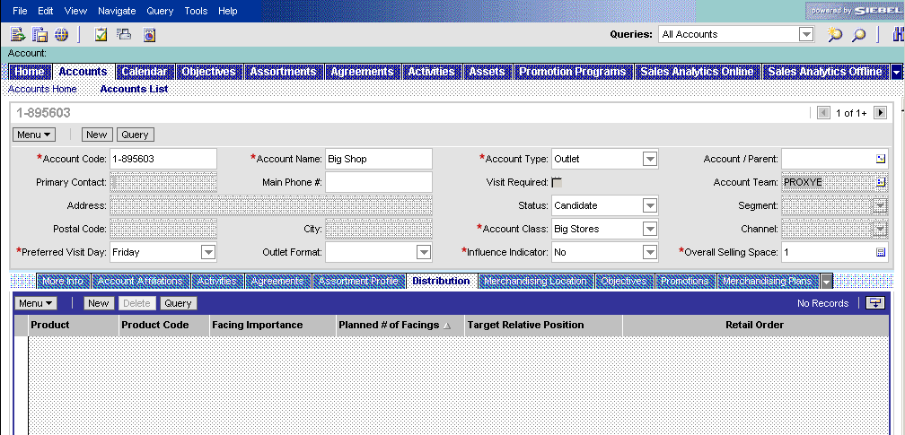
F.6. Ensure execution at PoP/PoC
Tool support – Distribution view
In the Account screen, the Trade Marketer can
review the details of the planned and active
assortment and space propositions in the distribution
view
1
2

Slide 33
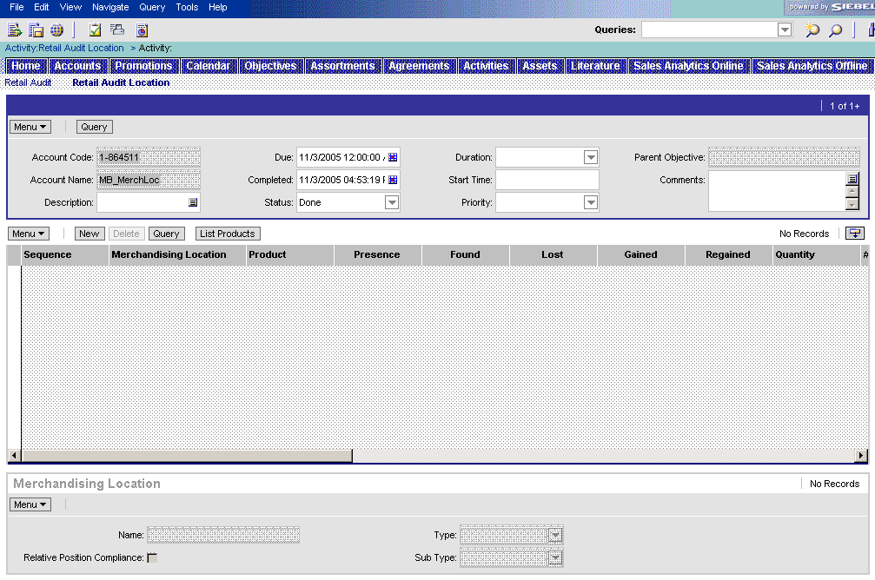
F.6. Ensure execution at PoP/PoC
Tool support – Retail audit view
During retail audit, the Trade marketer needs to
review fields and fill out other fields
Read-only fields (copied from distribution list when
pushing the “List Products” button)
  Product
  Product Code
  Facing importance
  Planned # Facings
  Target Relative Position

Slide 34
F.7. Measure & Evaluate Effectiveness
Tool support
The Space Management loop is completed when
the Category Developer measures and evaluates the
compliance of the Space Proposition he had
implemented
Siebel Analytics provides one main dashboard for this exercise, i.e.
the Evaluate Spacing
The dashboards contains following reports:
  Percentage of non-compliance outlets
  List of compliant outlets
  List of non-compliant outlets
  Overview of non-compliance reasons
  Spacing compliance by outlet
  Spacing compliance by product
All these reports can be filtered for a specific channel, account, geographic area, product level or time period

Slide 35
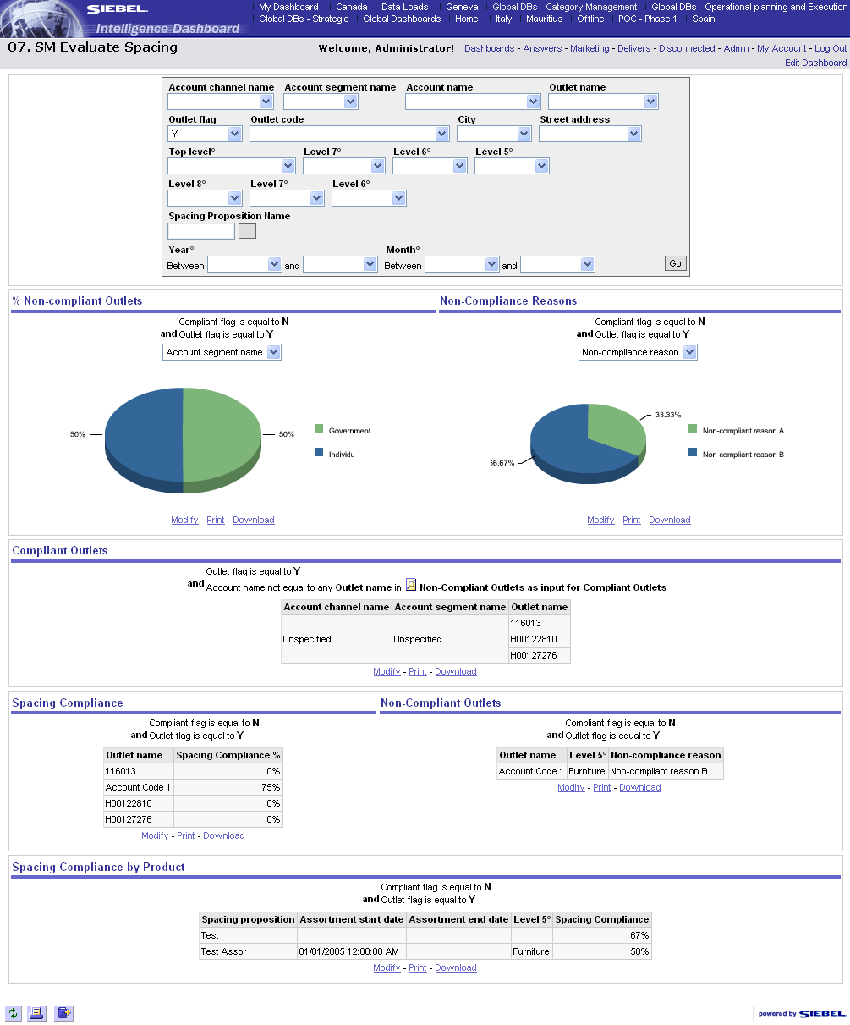
F.7. Measure & Evaluate Effectiveness
Dashboard – Evaluate spacing
1
2
3
4
5
5
Measure compliance of the spacing proposition
Select values for the query
Select the assortment that you want to analyze
Define the time period
Click GO
Modify the graphs by selecting other analysis critria in the column selector

Slide 36
Table of Contents
Introduction to Better Practices for Space Management
  Definition
  Process Overview
  Capability Interdependencies
Tool support for Space Management processes
  JTI versus Siebel Terms
  Tool support
  Tool step overview by BP process
  Tool steps in detail
Demo & Exercises
  Tool demo
  Exercises
Notes:
As presented this morning by Roberto, Martin, Andrew, the new markets dynamics and challenges will require a new approach & strategy on how we will tackle the trade marketing activities.
And as a result, we have defined some Better Practices to support the new ways of working on the Trade Marketing
But, What does this mean from Better Practices & New ways of working?
We have discovered the new 10 capabilities that will support this process and Right Now, let’s review together how the “IT tools” will support them.

Slide 37
Space Management
Live demo in Siebel Applications
Story Line
  In Italy, the Grand Prix is taking place in Monza in September 2005. JTI is sponsoring F1 racing through several brands in different teams. Special trade marketing actions have been identified for the non-strategic outlets in the 10 km geographic area around Monza.
  A large increase in sales is expected. The Category Developer is setting up a cluster with temporary deviation to meet the assortment needs

Slide 38
Table of Contents
Introduction to Better Practices for Space Management
  Definition
  Process Overview
  Capability Interdependencies
Tool support for Space Management processes
  JTI versus Siebel Terms
  Tool support
  Tool step overview by BP process
  Tool steps in detail
Demo & Exercises
  Tool demo
  Exercises
Notes:
As presented this morning by Roberto, Martin, Andrew, the new markets dynamics and challenges will require a new approach & strategy on how we will tackle the trade marketing activities.
And as a result, we have defined some Better Practices to support the new ways of working on the Trade Marketing
But, What does this mean from Better Practices & New ways of working?
We have discovered the new 10 capabilities that will support this process and Right Now, let’s review together how the “IT tools” will support them.

Slide 39
Tool exercises for Space Management
#1: Add space proposition to assortment plan
Will be part of Self-Paced exercises

Slide 40
Summary : Learning objectives of this module
You are now able to
  Understand how the TME applications support the BP processes for Space Management
  Create Space Propositions
  Review Space data in Siebel Analytics
Notes:
Review key objectives as documented on the slide with your participants.
The Better Practices based on the 10 capabilities will require New ways of working and the IT systems and tools will support and enable them!

Slide 41
Next steps after the training session
Based on what you have learned, your next steps are
  Familiarize with the Siebel applications
  Execute the Self-Paced exercises available on the TME University Portal
  Localize training material
  Train other users in your market
  Attend more upcoming intermediate and advanced trainings to complete your knowledge of Space Management

